Slide 1

NYU TANDON CAREER HUB · FALL 2026
Data Science Bootcamp
Week 2 · Numpy & Pandas
Instructor: Angelin Ann Jacob
Section 1 · Tue Oct 6
Section 2 · Thu Oct 8
Notes:
Welcome everyone. Today has two halves: first, how the next nine weeks work; then we jump straight into Python using a dataset you all helped create.

Slide 2
Useful Links
Zoom
Brightspace
GitHub
All sessions are virtual. Use ONLY your NYU SSO Login to be considered for attendance
Assignments, submissions and the discussion board, monitored Monday to Thursday.
Slides and Colab notebooks for every session.
Email
1:1 coaching
datasciencebootcamp@nyu.edu for questions, extensions and attendance approvals.
Optional 30-minute technical interview prep. Book it through Handshake.
Data Science Bootcamp · Fall 2026
07
Notes:
Coaching path in Handshake: Undergraduate/Graduate Students, then NYU Tandon Career Hub, then Technical Interview Prep Appointment. Discussion board hours are in the syllabus.

Slide 3
Numpy & Pandas
Get to the libraries used in your day to day tasks as a Data Specialist!
Data Science Bootcamp · Fall 2026
Notes:
Open the Week 1 notebook in Colab and upload responses.csv from the Files panel. We'll run a full, if modest, exploratory data analysis using only the standard language, so nothing happens by magic.

Slide 4
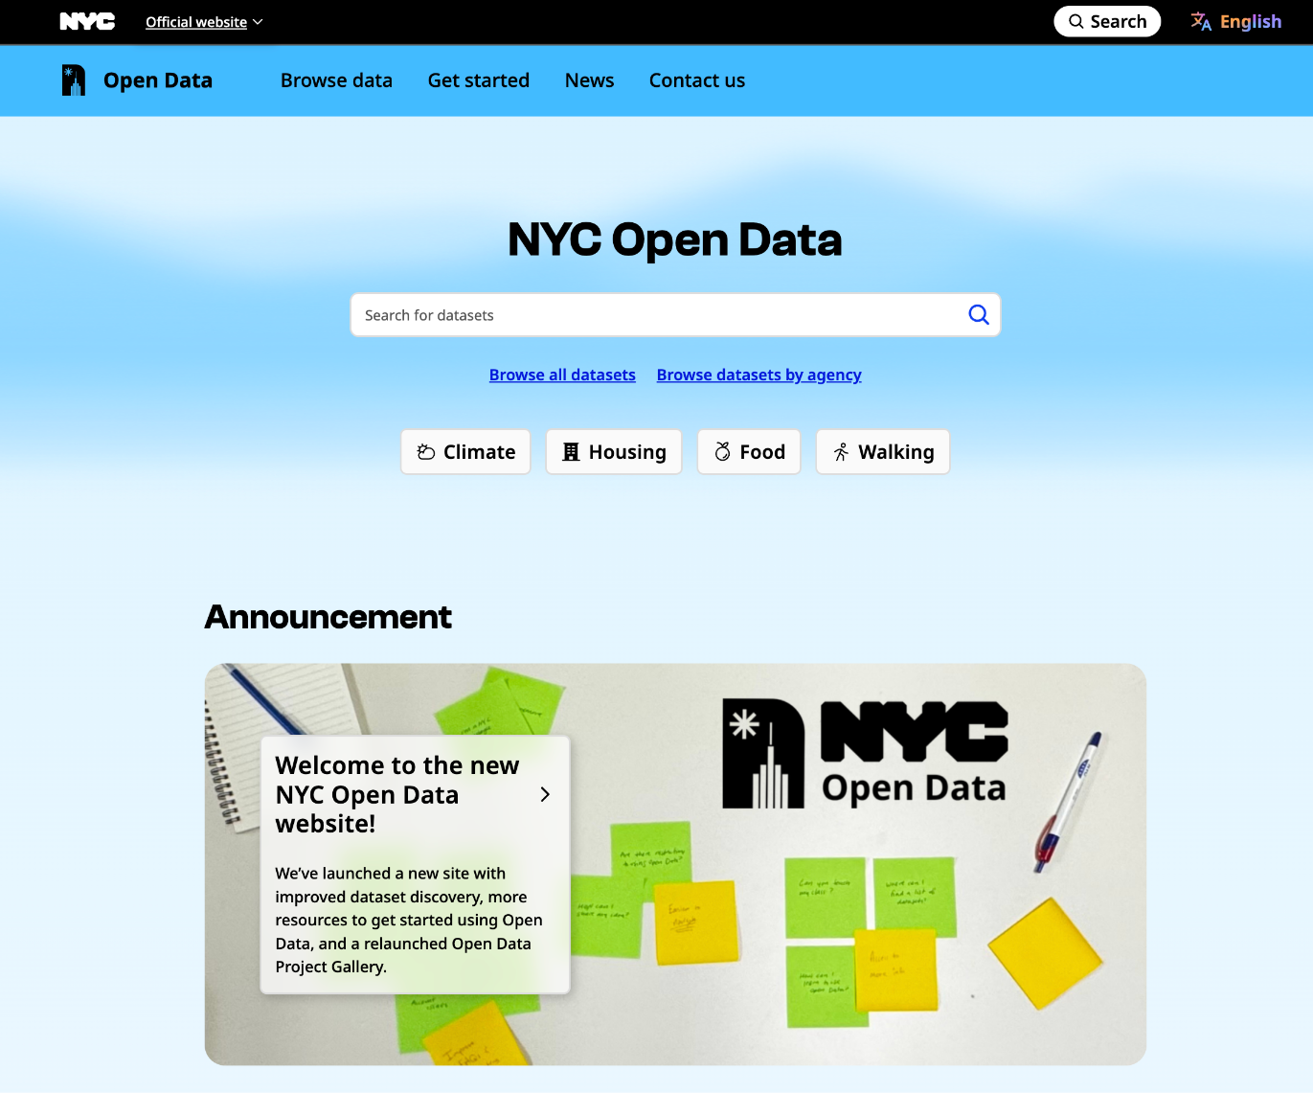
NYC Open Data
https://www.nyc.gov/opendata
Dataset name:
Brooklyn Bridge Automated Pedestrian Counts Demonstration Project (Historic)
Data Provided By:
Department of Transportation (DOT)
Visit: NYC Open Data - City of New York - Brooklyn Bridge Automation
02
Data Science Bootcamp · Fall 2026
Notes:
Same topic both days each week; you must stay in your chosen section. Highlighted rows are the two project presentation weeks. No sessions Thanksgiving week, but the team is available for questions and 1:1 coaching, so use that week for your project.

Slide 5
HOW TO READ TODAY'S SESSION
Two parts for every code block
THE STORY
THE TOOL
The question about the bridge
The library and function
What we want to know, in plain English.
When do people cross? Which direction dominates? Does rain matter?
How we get the answer, in code.
np.reshape() pd.read_csv()
df.groupby() df.sort_values()
EXAMPLE
bridge.groupby("hour")
.pedestrians.mean()
Story: Which hours of the day are busiest?
Data Science Bootcamp · Fall 2026
‹#›
Notes:
Same topic both days each week; you must stay in your chosen section. Highlighted rows are the two project presentation weeks. No sessions Thanksgiving week, but the team is available for questions and 1:1 coaching, so use that week for your project.

Slide 6
PART 1 · NUMPY · INDEXING & SLICING
Pick out exactly what you need
0
1
2
3
4
pedestrians[:5]
Five real counts, two ways to number them: from the front, or from the back.
Spot-check random hours with np.random.randint.
44
30
25
20
18
-5
-4
-3
-2
-1
THE STORY
THE STORY
THE STORY
Which hour was recorded first? Which last?
Pull out one full day, or the same hour every day.
Edit a slice. Does the original change?
THE TOOL
THE TOOL
THE TOOL
pedestrians[0]
pedestrians[-1]
direction[0, 0]
a[:24] # one day
a[::24] # every 24th
a[::-1] # newest first
view = a[:5]
view[0] = -1 # a too?!
a[:5].copy()
Data Science Bootcamp · Fall 2026
‹#›
Notes:
STORY: before trusting a long list of numbers, look at pieces of it: the first hour, the last hour, one full day, the same hour every day.
Top picture: the first five hourly counts from our data (44, 30, 25, 20, 18). Same five numbers, two ways to count them: from the front (0 to 4) or from the back (-5 to -1).
Column 1 is indexing, column 2 is slicing with start:stop:step (stop is excluded), column 3 is the surprise.
CURIOUS hook for column 3: a slice is a view, not a copy. Change the slice and the original array changes too. .copy() is the cure. Let them predict before you run it.
Also mention np.random.randint for random spot checks: a good habit with big tables.
Try it 2: first and last count with negative indexing, then a two-column array and the Manhattan-bound count from row 0.

Slide 7
PART 1 · NUMPY · RESHAPING & AXES
Turn hours into days
44
30
25
20
18
…
THE STORY
7,296 hourly counts in one row
Which hours are busiest on a typical day?
reshape((304, 24))
One row per day, one column per hour.
Encoding columns and rows with positional info!
24 hours →
axis=0
collapse the days: one typical day
THE TOOL
axis=1
grid = ped.reshape((304, 24))
grid.mean(axis=0)
grid.sum(axis=1)
typical_day[np.newaxis, :]
np.where(cond, "busy", "quieter")
collapse the hours: one total per day
304 days ↓
Data Science Bootcamp · Fall 2026
‹#›
Notes:
STORY: a year of hourly counts is one long row of numbers. To compare days we need a grid with one row per day and one column per hour. Then we squash the grid down into a typical day.
Left picture: 7,296 hourly counts in a row become a 304 x 24 grid. Our study window runs 1 Oct 2017 to 1 Aug 2018, which is 304 days, and 304 x 24 = 7,296.
TOOL: reshape. The number of values must match, so we check the length first.
axis tells NumPy which direction to collapse: axis=0 collapses the days and leaves 24 hourly values (a typical day); axis=1 collapses the hours and leaves 304 daily totals.
np.newaxis turns a 24-value profile into a row so NumPy can line it up against the whole grid. np.where makes element-by-element decisions, for example which direction dominates each hour.
Try it 3: first seven days, total per day with sum(axis=1), which day is largest, and show that day's 24 values.

Slide 8
PART 2 · PANDAS · THE TABLE
Meet the table
THE STORY
THE TOOL
What did we just load? How big is it?
bridge.head() bridge.tail()
bridge.shape bridge.info()
Typical values. Is the mean far from the median?
bridge.describe()
bridge.dtypes
How many people in total? How common is each weather?
bridge["Pedestrians"].sum()
bridge["weather_summary"].value_counts()
Busiest hours? Rainy versus dry? The single busiest hour?
bridge.sort_values(ascending=False)
bridge[bridge["precipitation"] > 0]
bridge.loc[bridge["Pedestrians"].idxmax()]
Data Science Bootcamp · Fall 2026
‹#›
Notes:
Now the table itself. pandas keeps labels on rows and columns and lets each column have its own type. The two objects to know: DataFrame (the table) and Series (one column).
Row 1: what did we just load? head, tail, shape (rows, columns) and info. Row 2: describe gives headline statistics; compare the mean and the median of Pedestrians and ask what the gap suggests. dtypes shows the type of every column.
Row 3: sum and value_counts answer how many people and how common each weather label is.
Row 4 is the busiest-hours story: sort_values, a True/False filter for rainy hours, then idxmax to find the busiest row and .loc to read it in full.
CURIOUS hook: idxmax does not give you the count, it gives you something else. Ask what it hands back and why that is the key to .loc.
Try it 4: use head, tail, shape, describe and dtypes to answer four questions about the table.

Slide 9
PART 2 · PANDAS · GROUPING
Group, compare, summarize
Every hourly row
analysis.groupby("hour")
.pedestrians.mean()
one row = one hour
split into 24 piles, one per hour
one number per pile: a Series
THE STORY
THE STORY
THE STORY
Tidy names, then pull out the hour.
Mean, min and max for every weather label.
Readable labels, and tables we build ourselves.
THE TOOL
THE TOOL
THE TOOL
df.rename(columns={...})
df.pedestrians
df["time"].dt.hour
.groupby("weather_summary")
.agg([...])
.describe()
.apply(lambda q: ...)
pd.Series(...)
pd.DataFrame({...})
Data Science Bootcamp · Fall 2026
‹#›
Notes:
STORY: when do people cross, and does weather change the crowd? The answer is to compare groups of rows with each other: all the 3 PM hours against all the other 3 PM hours, every rainy hour against every dry one.
TOOL: groupby. Think of it as split, apply, combine. Split the rows into 24 piles by hour (we first make an hour column with .dt.hour), apply mean to each pile, and get one number per pile back, which is a Series.
Column 1: rename tidies column names with spaces so we can use dot access, and it returns a new table. Column 2: the same groupby idea with several statistics via agg, plus describe for the full spread. Column 3: apply with a lambda to make weather labels readable, and building a Series or a DataFrame ourselves.
CURIOUS hook (the notebook's extra challenge): why is a groupby result sometimes a Series and sometimes a DataFrame?
Try it 5: mean pedestrians per hour of day, sorted from busiest to quietest, report the top hour. Then point to the take-home and the Final Investigation.

Slide 10
Before next week
Take-home
Feedback form
Week 3: EDA and Data Exploration
The exercises at the end of today's notebook. Submit on Brightspace within one week, by 11:59 PM.
Fill it out after today's session. It counts toward your credential.
Work with datasets and explore trends and data stories.
Data Science Bootcamp · Fall 2026
Notes:
Take-home exercises are at the end of the notebook, with an extended challenge for anyone who wants more. Week 2 is Oct 6 for Section 1 and Oct 8 for Section 2.

